Slide 1
Atliq Hardware
Consumer Goods
Ad-HOC-Insights
Presented by: Prafful Sharma

Slide 2
Company’s Overview
Atliq hardware is a well known hardware manufacturing company.
It’s business is spread all around the globe.
It is currently doing business in 27 countries.
It has major market share in hardware industry.
Atliq has 3 divisions Peripherals & Accessories, Personal Computers, and Networking & Storage.
Atliq hardware generates business from three ways. The one is from Brick & Mortar Customers another one is distributers and the other is from their own stores.

Slide 3
Objectives
The management noticed that they are not getting enough insights to make quick and smart decisions.
So in order to that they expand their data analyst team and hire Tony Sharma as Senoir Data Analyst and Peter Pandey as Junior data analyst.
Now they perform data analysis in various domains using SQL.
They perform Financial Analytics, Supply chain analytics, Top customer, product, market analysis.
Data Analytics team has to present the insights to Key Stakeholders.
Now, we come to the requirements generated by the stakeholders and present the Key insights from the data.

Slide 4
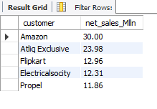
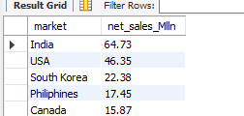
Statement 1: Manager wants a report for Top 5 customers in India with respect to net sales in millions in financial year 2021.
Statement 2: Manager wants a report for Top 5 Markets by net sales in millions in financial year 2020.

Slide 5
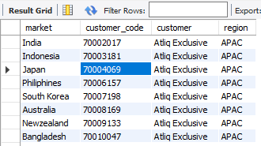
1. Provide the list of markets in which customer "Atliq Exclusive" operates its business in the APAC region.

Slide 6
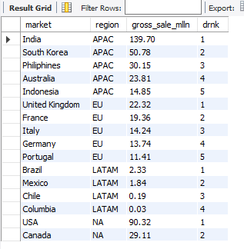
Statement 3: Manager wants a report for Top 5 markets in a region by gross sales in millions in financial year 2021.

Slide 7

Statement 4: Manager wants to know which badge (Gold, Silver) will USA market belongs to in financial year 2021.
If Sold quantity>500000 then the market is Gold else it is Silver.

Slide 8
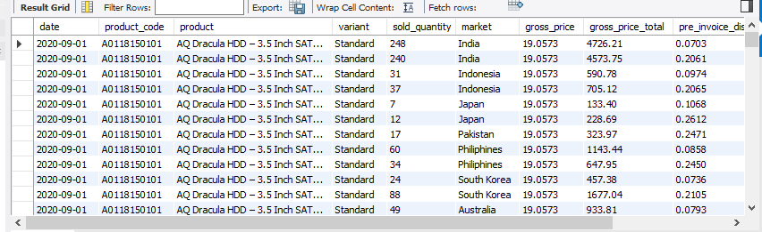
Statement 5: Manager wants to get Gross sales report for monthly product transaction.

Slide 9
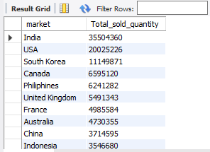
Statement 6: Manager wants to get a report on total sold quantity in different markets in descending order.

Slide 10
THANKS FOR WATCHING

